Slide 1
“Fredericton Pro Painters”
Management and Operations

Slide 2
https://certapro.com/

Slide 3
Fred Pro Paint
Timeline:
March-register the business, decide on a target market, print business cards, set up Facebook page, offer free estimates, print a magnetic sign for your vehicle and create a powerful name, logo, mission statement and trendy slogan.
Advertise for personal, or gather a team or friends, partners and establish your organizational/management structure.
March April May receive contracts for painting. No more contracts past Aug 15, to finish up jobs and liquidate the business.

Slide 4
June July Aug
How would you organize this summer Venture?
You’re the leader, boss, owner- how will you plan?
Teams, groups, one house at a time, many at once. Who will take calls, do estimates, make sure job is complete, get paid. Get supplies, idle workers cost you money, and so does unhappy customers.

Slide 5
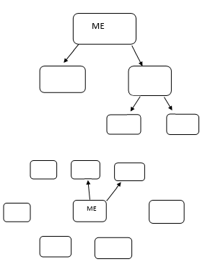

Slide 6
Organizational/Management structure:
Receive calls, give estimates, quote prices, plan projects, order supplies, pay the bills and write the pay cheques.
2. Painter, Lead team one.
3. Painter, Lead team two
4. Painter, Lead team 3
5. Painter
6. Painter
7. Painter

Slide 7
Sole Proprietor
P1 P2 P3 P4 P5 P6 P7 P8
Forman 1
F2
F3
F4
Accountant
Web Developer

Slide 8
Partner1
P2
P3
p4
3 Painter
Crew
C2
C3
C4
Accountant
Web Developer

Slide 10
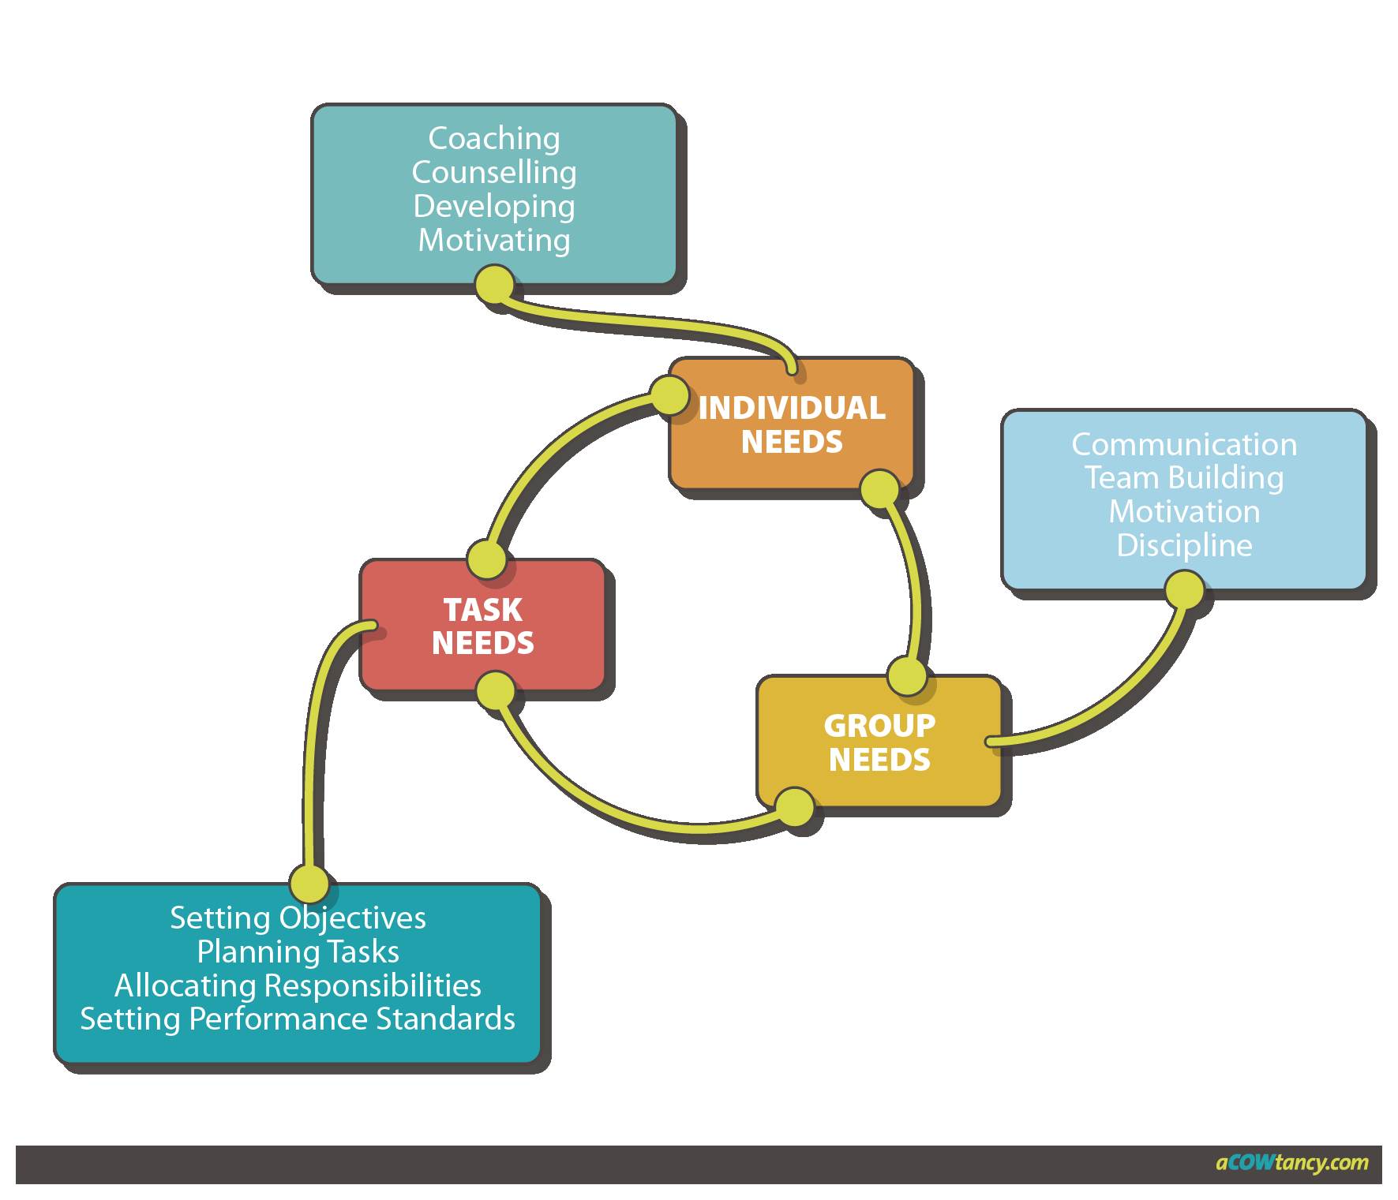

Slide 11
