Slide 1
Leadership

Slide 2
A Leadership Story:
A group of workers and their leaders are set a task of clearing a road through a dense jungle on a remote island to get to the coast where an estuary provides a perfect site for a port.
The leaders organise the labour into efficient units and monitor the distribution and use of capital assets – progress is excellent. The leaders continue to monitor and evaluate progress, making adjustments along the way to ensure the progress is maintained and efficiency increased wherever possible.
Then, one day amidst all the hustle and bustle and activity, one person climbs up a nearby tree. The person surveys the scene from the top of the tree.

Slide 3
A Leadership Story:
And shouts down to the assembled group below…
“Wrong Way! were going the Wrong Way!”
(Story adapted from Stephen Covey (2004) “The Seven Habits of Highly Effective People” Simon & Schuster).
“Management is doing things right, leadership is doing the right things”
(Warren Bennis and Peter Drucker)

Slide 4
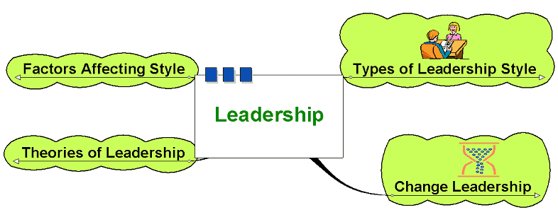
Leadership

Slide 5
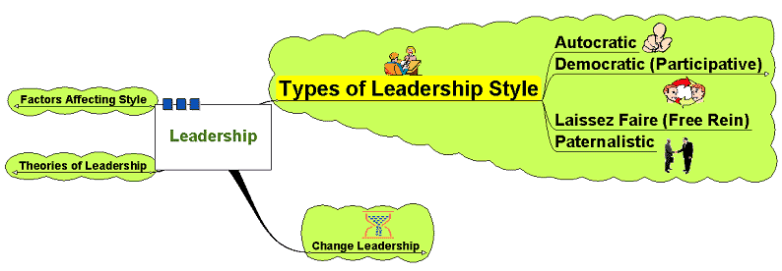
Types of Leadership Style

Slide 6
Types of Leadership Style
Autocratic:
Leader makes decisions without reference to anyone else
High degree of dependency on the leader
Can create de-motivation and alienation of staff
May be valuable in some types of business where decisions need to be made quickly and decisively

Slide 7
Types of Leadership Style
Democratic:
Encourages decision making from different perspectives – leadership may be emphasised throughout the organisation
Consultative: process of consultation before decisions are taken
Persuasive: Leader takes decision and seeks to persuade others that the decision is correct

Slide 8
Types of Leadership Style
Democratic:
May help motivation and involvement
Workers feel ownership of the firm and its ideas
Improves the sharing of ideas and experiences within the business
Can delay decision making

Slide 9
Types of Leadership Style
Laissez-Faire:
‘Let it be’ – the leadership responsibilities are shared by all
Can be very useful in businesses where creative ideas are important
Can be highly motivational, as people have control over their working life
Can make coordination and decision making time-consuming and lacking in overall direction
Relies on good team work
Relies on good interpersonal relations

Slide 10
Types of Leadership Style
Paternalistic:
Leader acts as a ‘father figure’
Paternalistic leader makes decision but may consult
Believes in the need to support staff

Slide 11
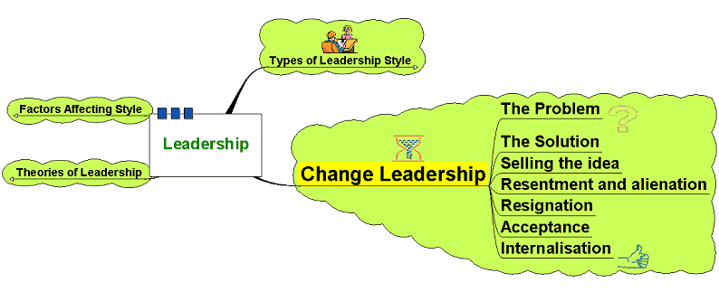
Change Leadership

Slide 12
Change Leadership
The most challenging aspect of business is leading and managing change
The business environment is subject to fast-paced economic and social change
Modern business must adapt and be flexible to survive
Problems in leading change stem mainly from human resource management

Slide 13
Change Leadership
Leaders need to be aware of how change impacts on workers:
Series of self-esteem states identified by Adams et al and cited by Garrett
Adams, J. Hayes, J. and Hopson, B.(eds) (1976) Transition: understanding and managing change personal change London, Martin Robertson
Garrett, V. (1997) Managing Change in School leadership for the 21st century Brett Davies and Linda Ellison, London, Routledge

Slide 14
Change Leadership
Self-esteem
1. Immobilisation – as rumours of the change circulate, the individual feels some sense of shock and possible disbelief – so much so that they deem it worthy of doing nothing.
2. Minimisation: As the change becomes clearer, people try to fit in the change with their own personal position and may try to believe that it will not affect them.
3. Depression: as reality begins to dawn staff may feel alienated and angry, feelings of a lack of control of events overtake people and they feel depressed as they try to reconcile what is happening with their own personal situation.
4. Acceptance/letting go: The lowest point in self-esteem finally sees people starting to accept the inevitable. Fear of the future is a feature of this stage.
5. Testing out: Individuals begin to interact with the change, they start to ask questions to see how they might work with the change.
6. Search for meaning: Individuals begin to work with the change and see how they might be able to make the change work for them – self esteem begins to rise.
7
2
7. Internalisation: the change is understood and adopted within the individual’s own understanding – they now know how to work with it and feel a renewed sense of confidence and self esteem.
6
3
1
5
4
Time

Slide 15
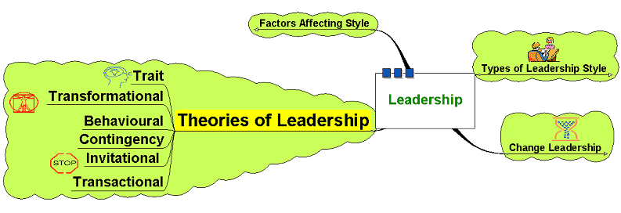
Theories of Leadership

Slide 16
Theories of Leadership
Trait theories:
Is there a set of characteristics that determine a good leader?
Personality?
Dominance and personal presence?
Charisma?
Self confidence?
Achievement?
Ability to formulate a clear vision?

Slide 17
Theories of Leadership
Trait theories:
Are such characteristics inherently gender biased?
Do such characteristics produce good leaders?
Is leadership more than just bringing about change?
Does this imply that leaders are born not bred?

Slide 18
Theories of Leadership
Behavioural:
Imply that leaders can be trained – focus on the way of doing things
Structure based behavioural theories – focus on the leader instituting structures – task orientated
Relationship based behavioural theories – focus on the development and maintenance of relationships – process orientated

Slide 19
Theories of Leadership
Contingency Theories:
Leadership as being more flexible – different leadership styles used at different times depending on the circumstance.
Suggests leadership is not a fixed series of characteristics that can be transposed into different contexts

Slide 20
Theories of Leadership
May depend on:
Type of staff
History of the business
Culture of the business
Quality of the relationships
Nature of the changes needed
Accepted norms within the institution

Slide 21
Theories of Leadership
Transformational:
Widespread changes to a business or organisation
Requires:
Long term strategic planning
Clear objectives
Clear vision
Leading by example – walk the walk
Efficiency of systems and processes

Slide 22
Theories of Leadership
Invitational Leadership:
Improving the atmosphere and message sent out by the organisation
Focus on reducing negative messages sent out through the everyday actions of the business both externally and, crucially, internally
Review internal processes to reduce these
Build relationships and sense of belonging and identity with the organisation – that gets communicated to customers, etc.

Slide 23
Theories of Leadership
Transactional Theories:
Focus on the management of the organisation
Focus on procedures and efficiency
Focus on working to rules and contracts
Managing current issues and problems

Slide 24
Factors Affecting Style

Slide 25
Factors Affecting Style
Leadership style may be dependent on various factors:
Risk - decision making and change initiatives based on degree of risk involved
Type of business – creative business or supply driven?
How important change is – change for change’s sake?
Organisational culture – may be long embedded and difficult to change
Nature of the task – needing cooperation? Direction? Structure?

